Slide 1
Introduction to Privacy Enhancing Technology

Slide 2
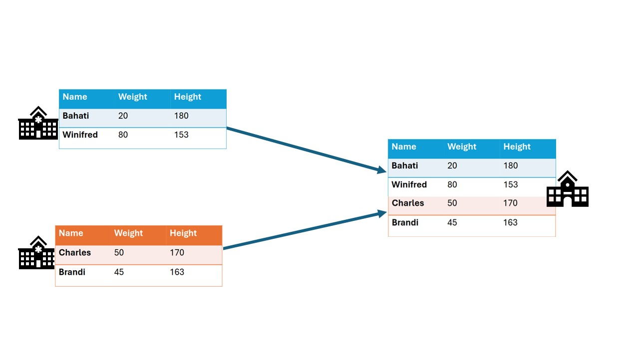
Classic analysis: Collect the data in one place
Notes:
Open source
Container orchestration for privacy enhancing techniques
Easily extensible to different types of data sources
Algorithms can be developed in any language
Other applications can connect using the API

Slide 3
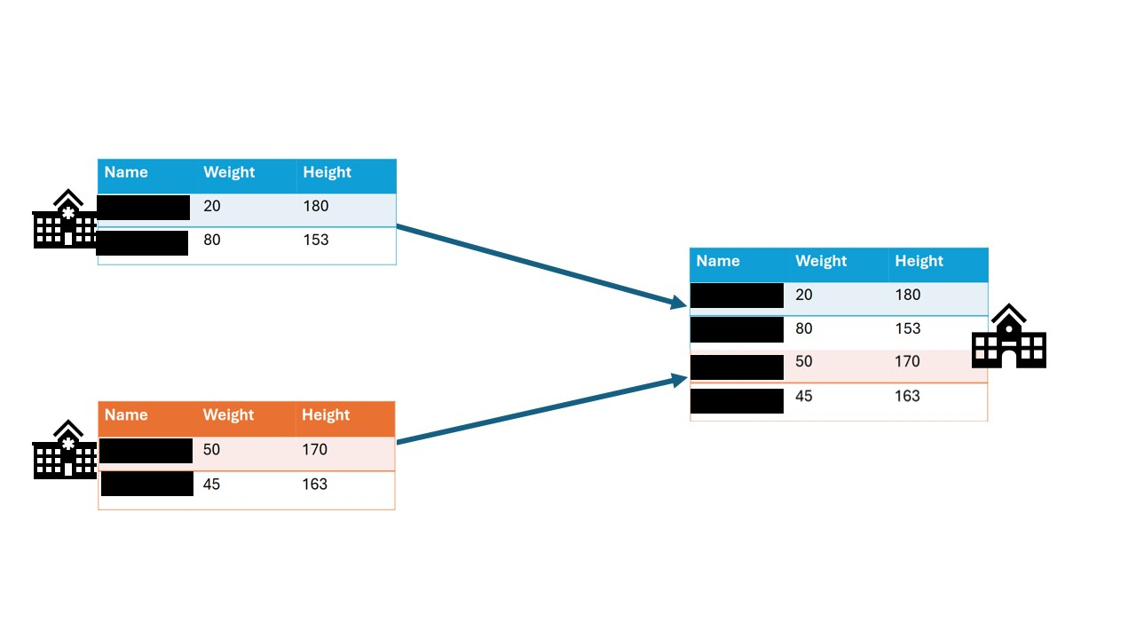
Data anonymization: Remove sensitive fields
Notes:
Open source
Container orchestration for privacy enhancing techniques
Easily extensible to different types of data sources
Algorithms can be developed in any language
Other applications can connect using the API

Slide 4
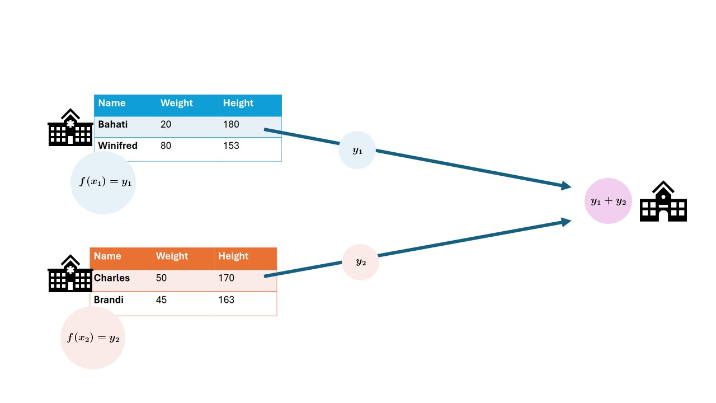
Federated data analysis: Send analysis to the source, then aggregate
Notes:
Open source
Container orchestration for privacy enhancing techniques
Easily extensible to different types of data sources
Algorithms can be developed in any language
Other applications can connect using the API

Slide 5
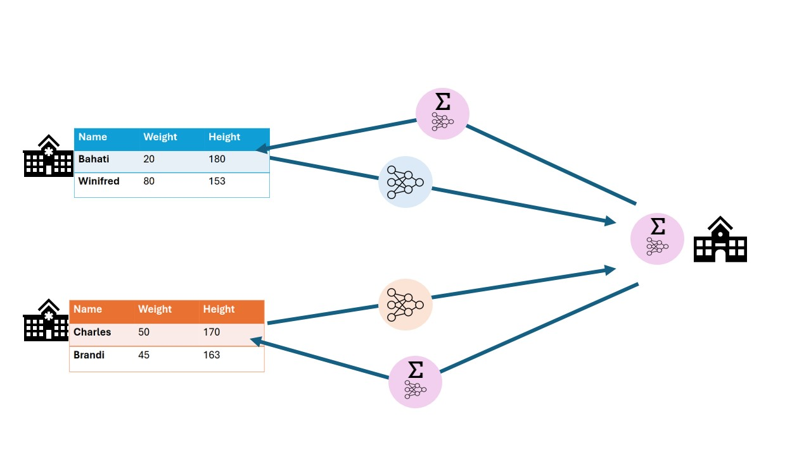
Federated learning: Train models locally, then aggregate
Notes:
Open source
Container orchestration for privacy enhancing techniques
Easily extensible to different types of data sources
Algorithms can be developed in any language
Other applications can connect using the API

Slide 6
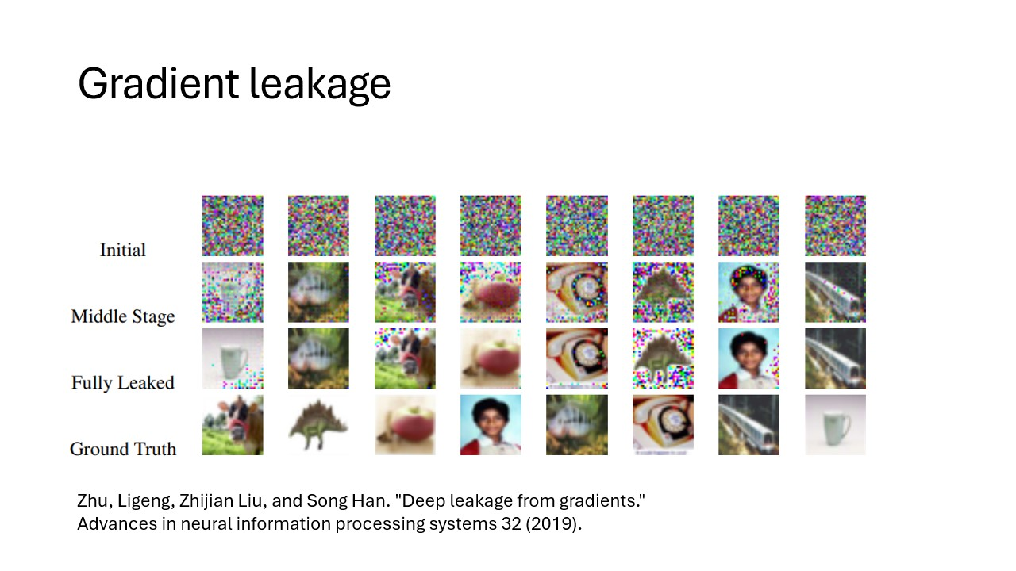
Federated learning and analysis can still leak data!
Notes:
Open source
Container orchestration for privacy enhancing techniques
Easily extensible to different types of data sources
Algorithms can be developed in any language
Other applications can connect using the API

Slide 7
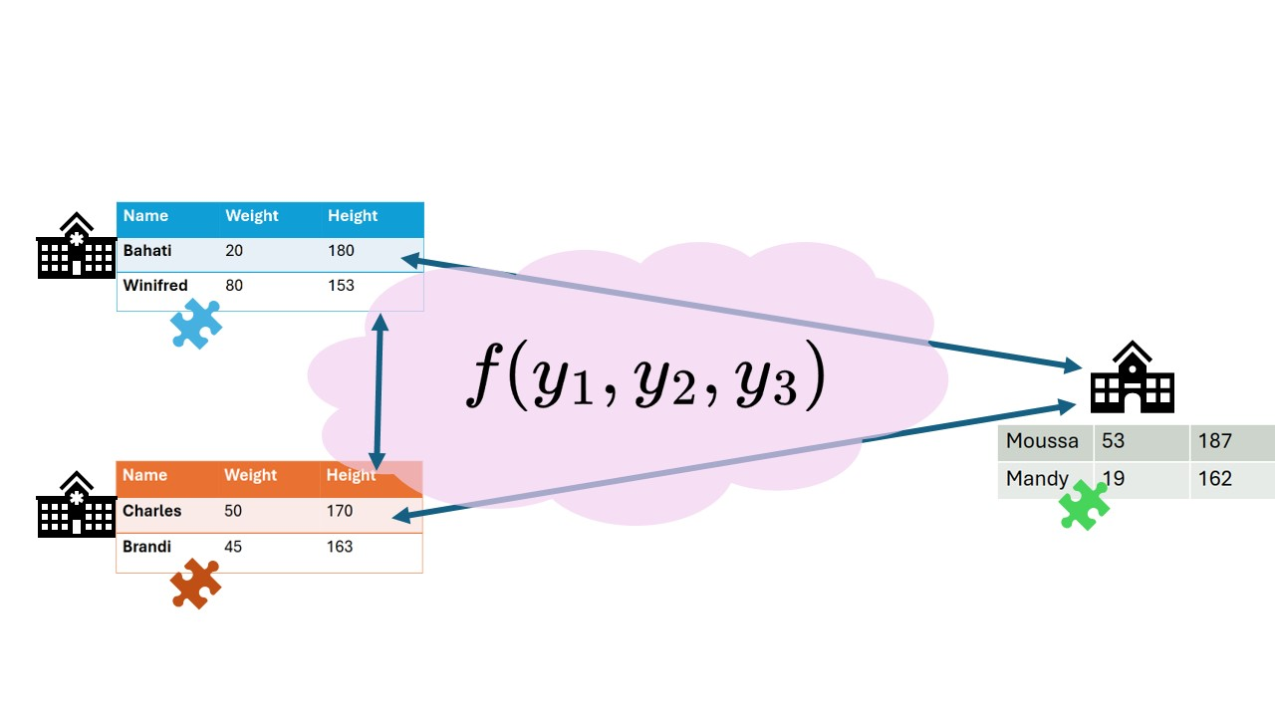
Secure multiparty computation: Send around encrypted puzzle pieces
Notes:
Open source
Container orchestration for privacy enhancing techniques
Easily extensible to different types of data sources
Algorithms can be developed in any language
Other applications can connect using the API

Slide 8
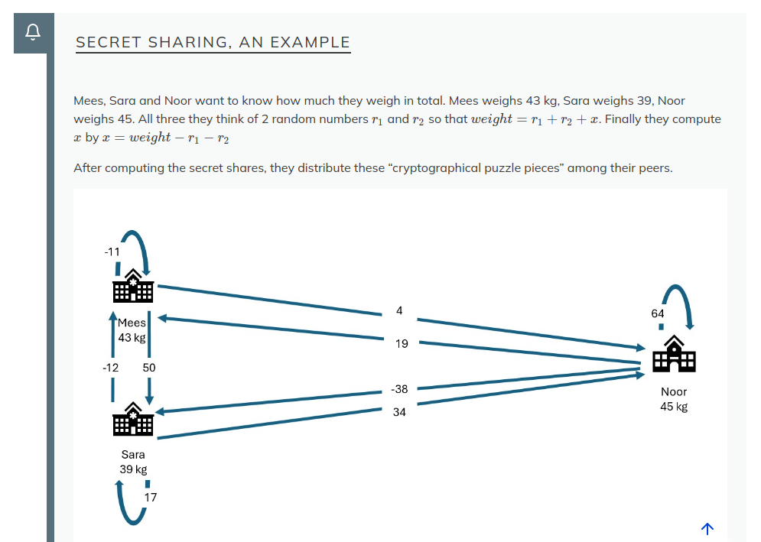
Secret sharing: an example
Notes:
Open source
Container orchestration for privacy enhancing techniques
Easily extensible to different types of data sources
Algorithms can be developed in any language
Other applications can connect using the API

Slide 9
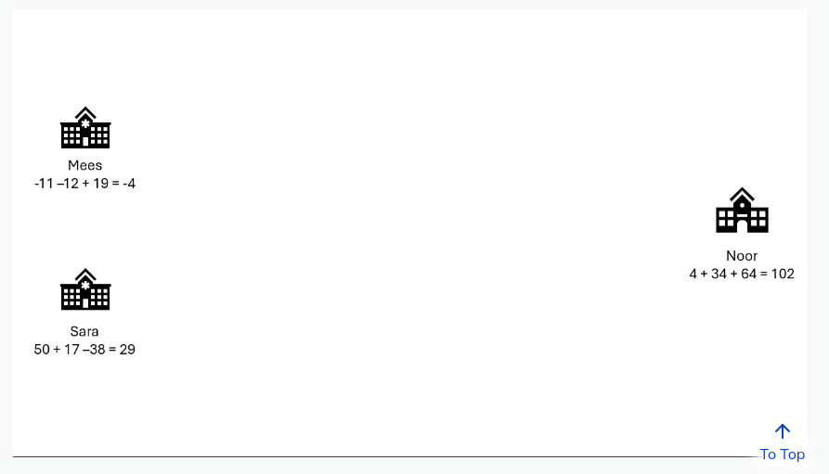
Secret sharing: an example
Notes:
Open source
Container orchestration for privacy enhancing techniques
Easily extensible to different types of data sources
Algorithms can be developed in any language
Other applications can connect using the API

Slide 10
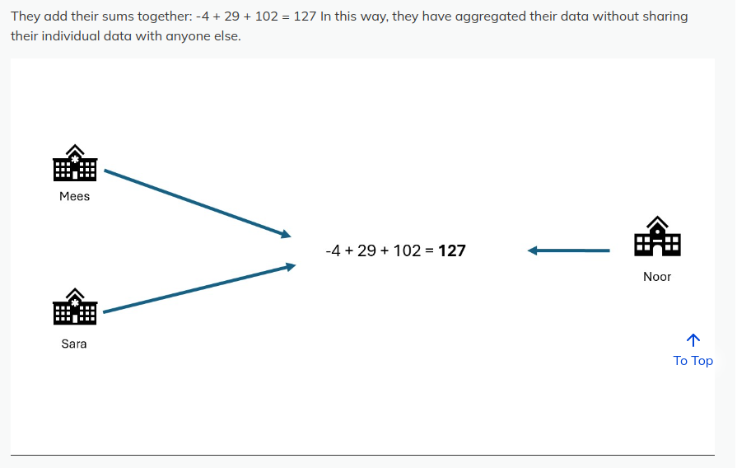
Secret sharing: an example
Notes:
Open source
Container orchestration for privacy enhancing techniques
Easily extensible to different types of data sources
Algorithms can be developed in any language
Other applications can connect using the API

Slide 11
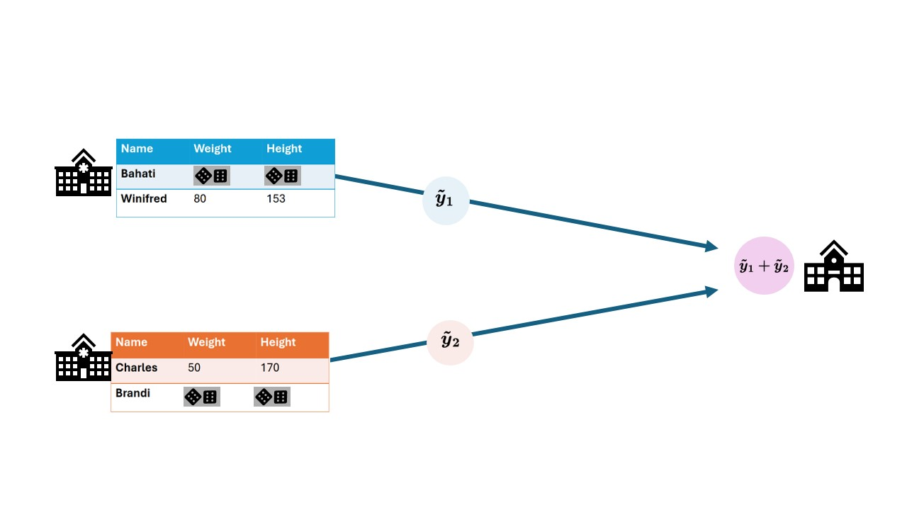
Differential privacy: Add noise
Notes:
Open source
Container orchestration for privacy enhancing techniques
Easily extensible to different types of data sources
Algorithms can be developed in any language
Other applications can connect using the API

Slide 12
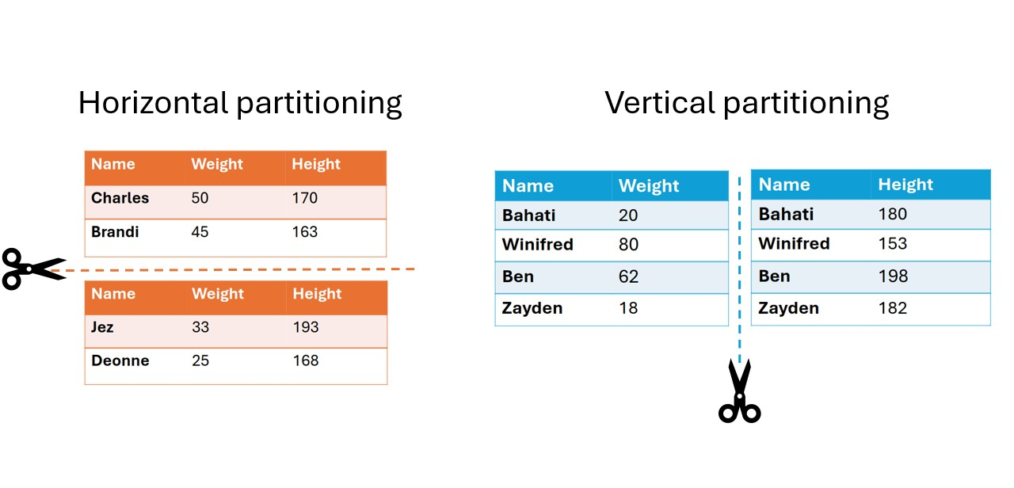
Data partitioning
Notes:
Open source
Container orchestration for privacy enhancing techniques
Easily extensible to different types of data sources
Algorithms can be developed in any language
Other applications can connect using the API

Slide 13

Projects usually combine techniques
Federated analysis as a base
Combine the ingredients using secret sharing
Peel off the identifying features from the records
Your delicious insights are ready to serve!
Sprinkle in some differential privacy

Slide 14
Technology doesn't solve everything!
Privacy enhancing technology is only a small part of the data sharing puzzle
Some other factors
Trust
Regulations (either general or specific to the location)
Data harmonization

